Slide 1
Just a pitch(?)
User experience: beyond the obvious

Slide 2
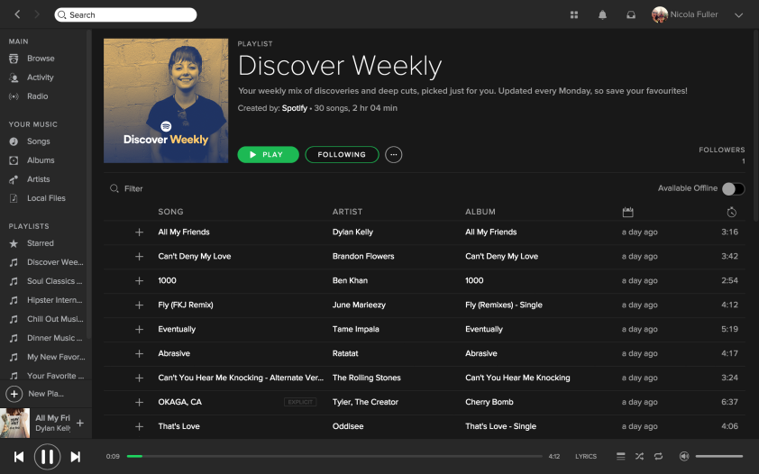

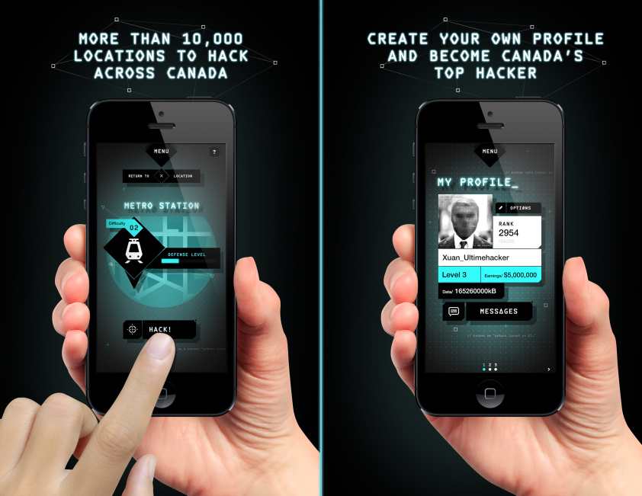
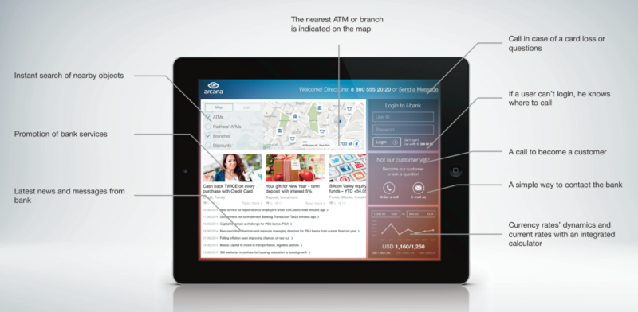
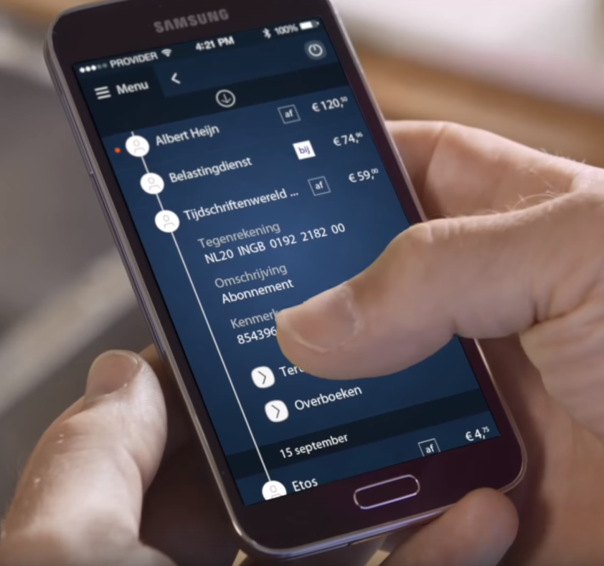
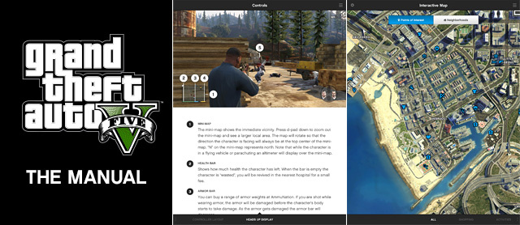
First off: what is UX? A few examples

Slide 3
UX findings - Take away points:
Humanization
Customization
Personalization
More than just buzz words. Combined, these 3 points enhance the UX to the max.
Tailoring to specific needs of individuals.

Slide 4
Two concepts
Personalized Internet banking app
Game assistance app

Slide 5
How do they conform to the UX findings? Meanwhile, solving the problems users have
Mobile banking
Personal contact
Transparency
More self control
Compensation for lacking features
Personalized user profiles
Game assistance app
Stay connected on the road
Influence your character outside of the actual game
Control your owned assets
Buy and sell in-game items
Communicate with friends

Slide 6
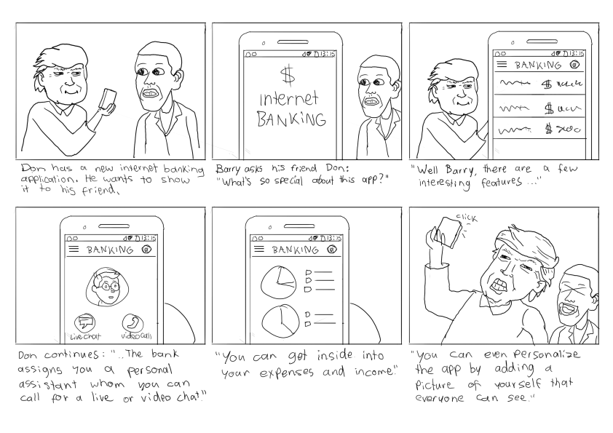
Mobile banking: Storyboard

Slide 7
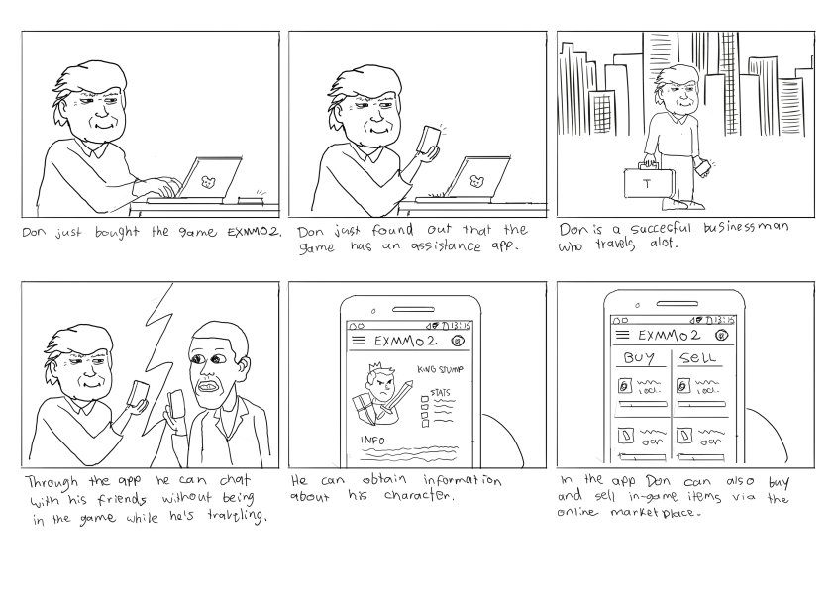
Game assistance app: Storyboard

Slide 8
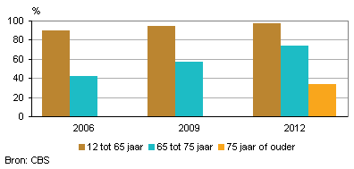
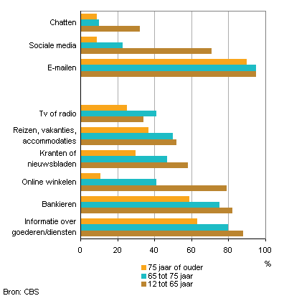
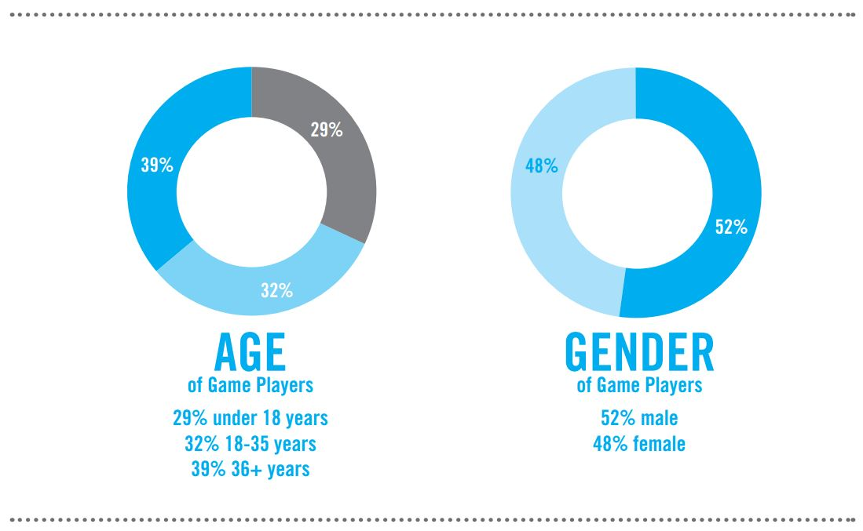
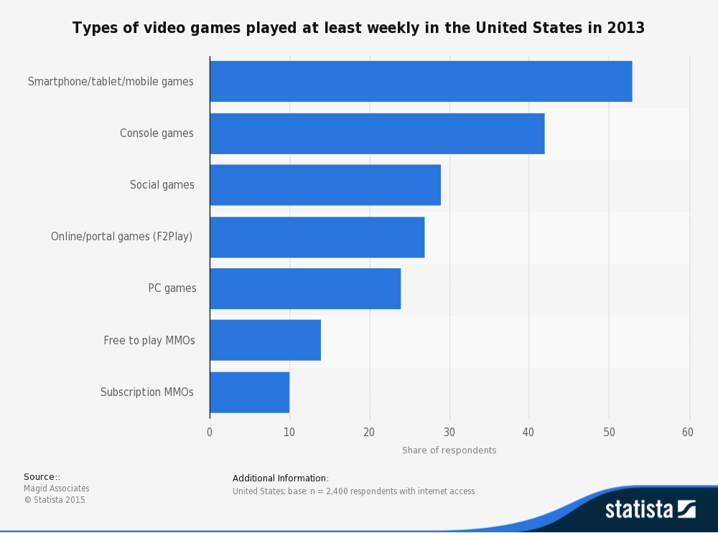
Serving the need of people… but who?
Mobile Banking:
Virtually everyone uses banking
Game Assistance app:
Potentially everyone that plays and/or wants to play EXMMO2

Slide 9
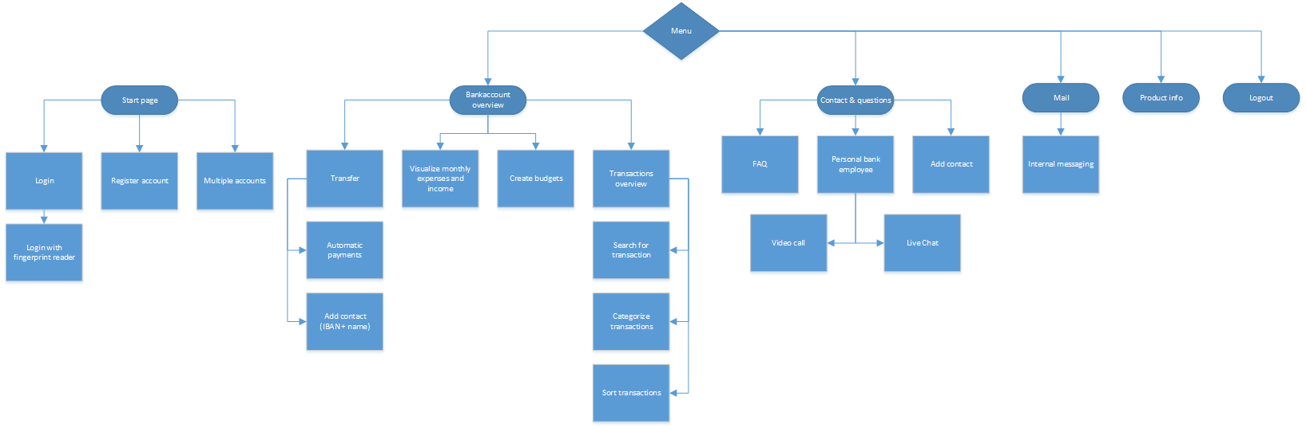
Information hierarchy: Mobile banking

Slide 10
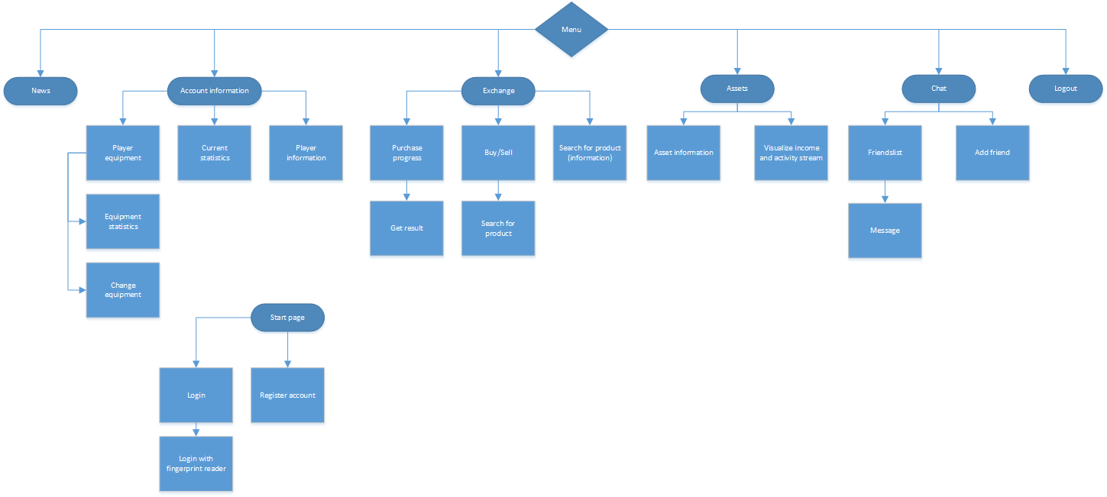
Information hierarchy: game assistance app

